Slide 1
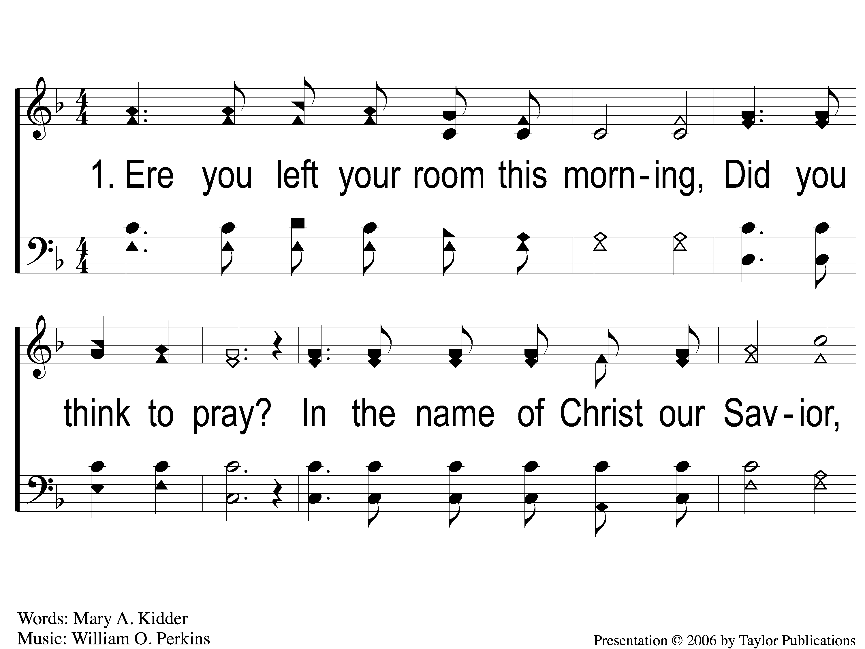
1-1 Ere You Left Your Room this Morning
Ere You Left Your Room this Morning
100

Slide 2
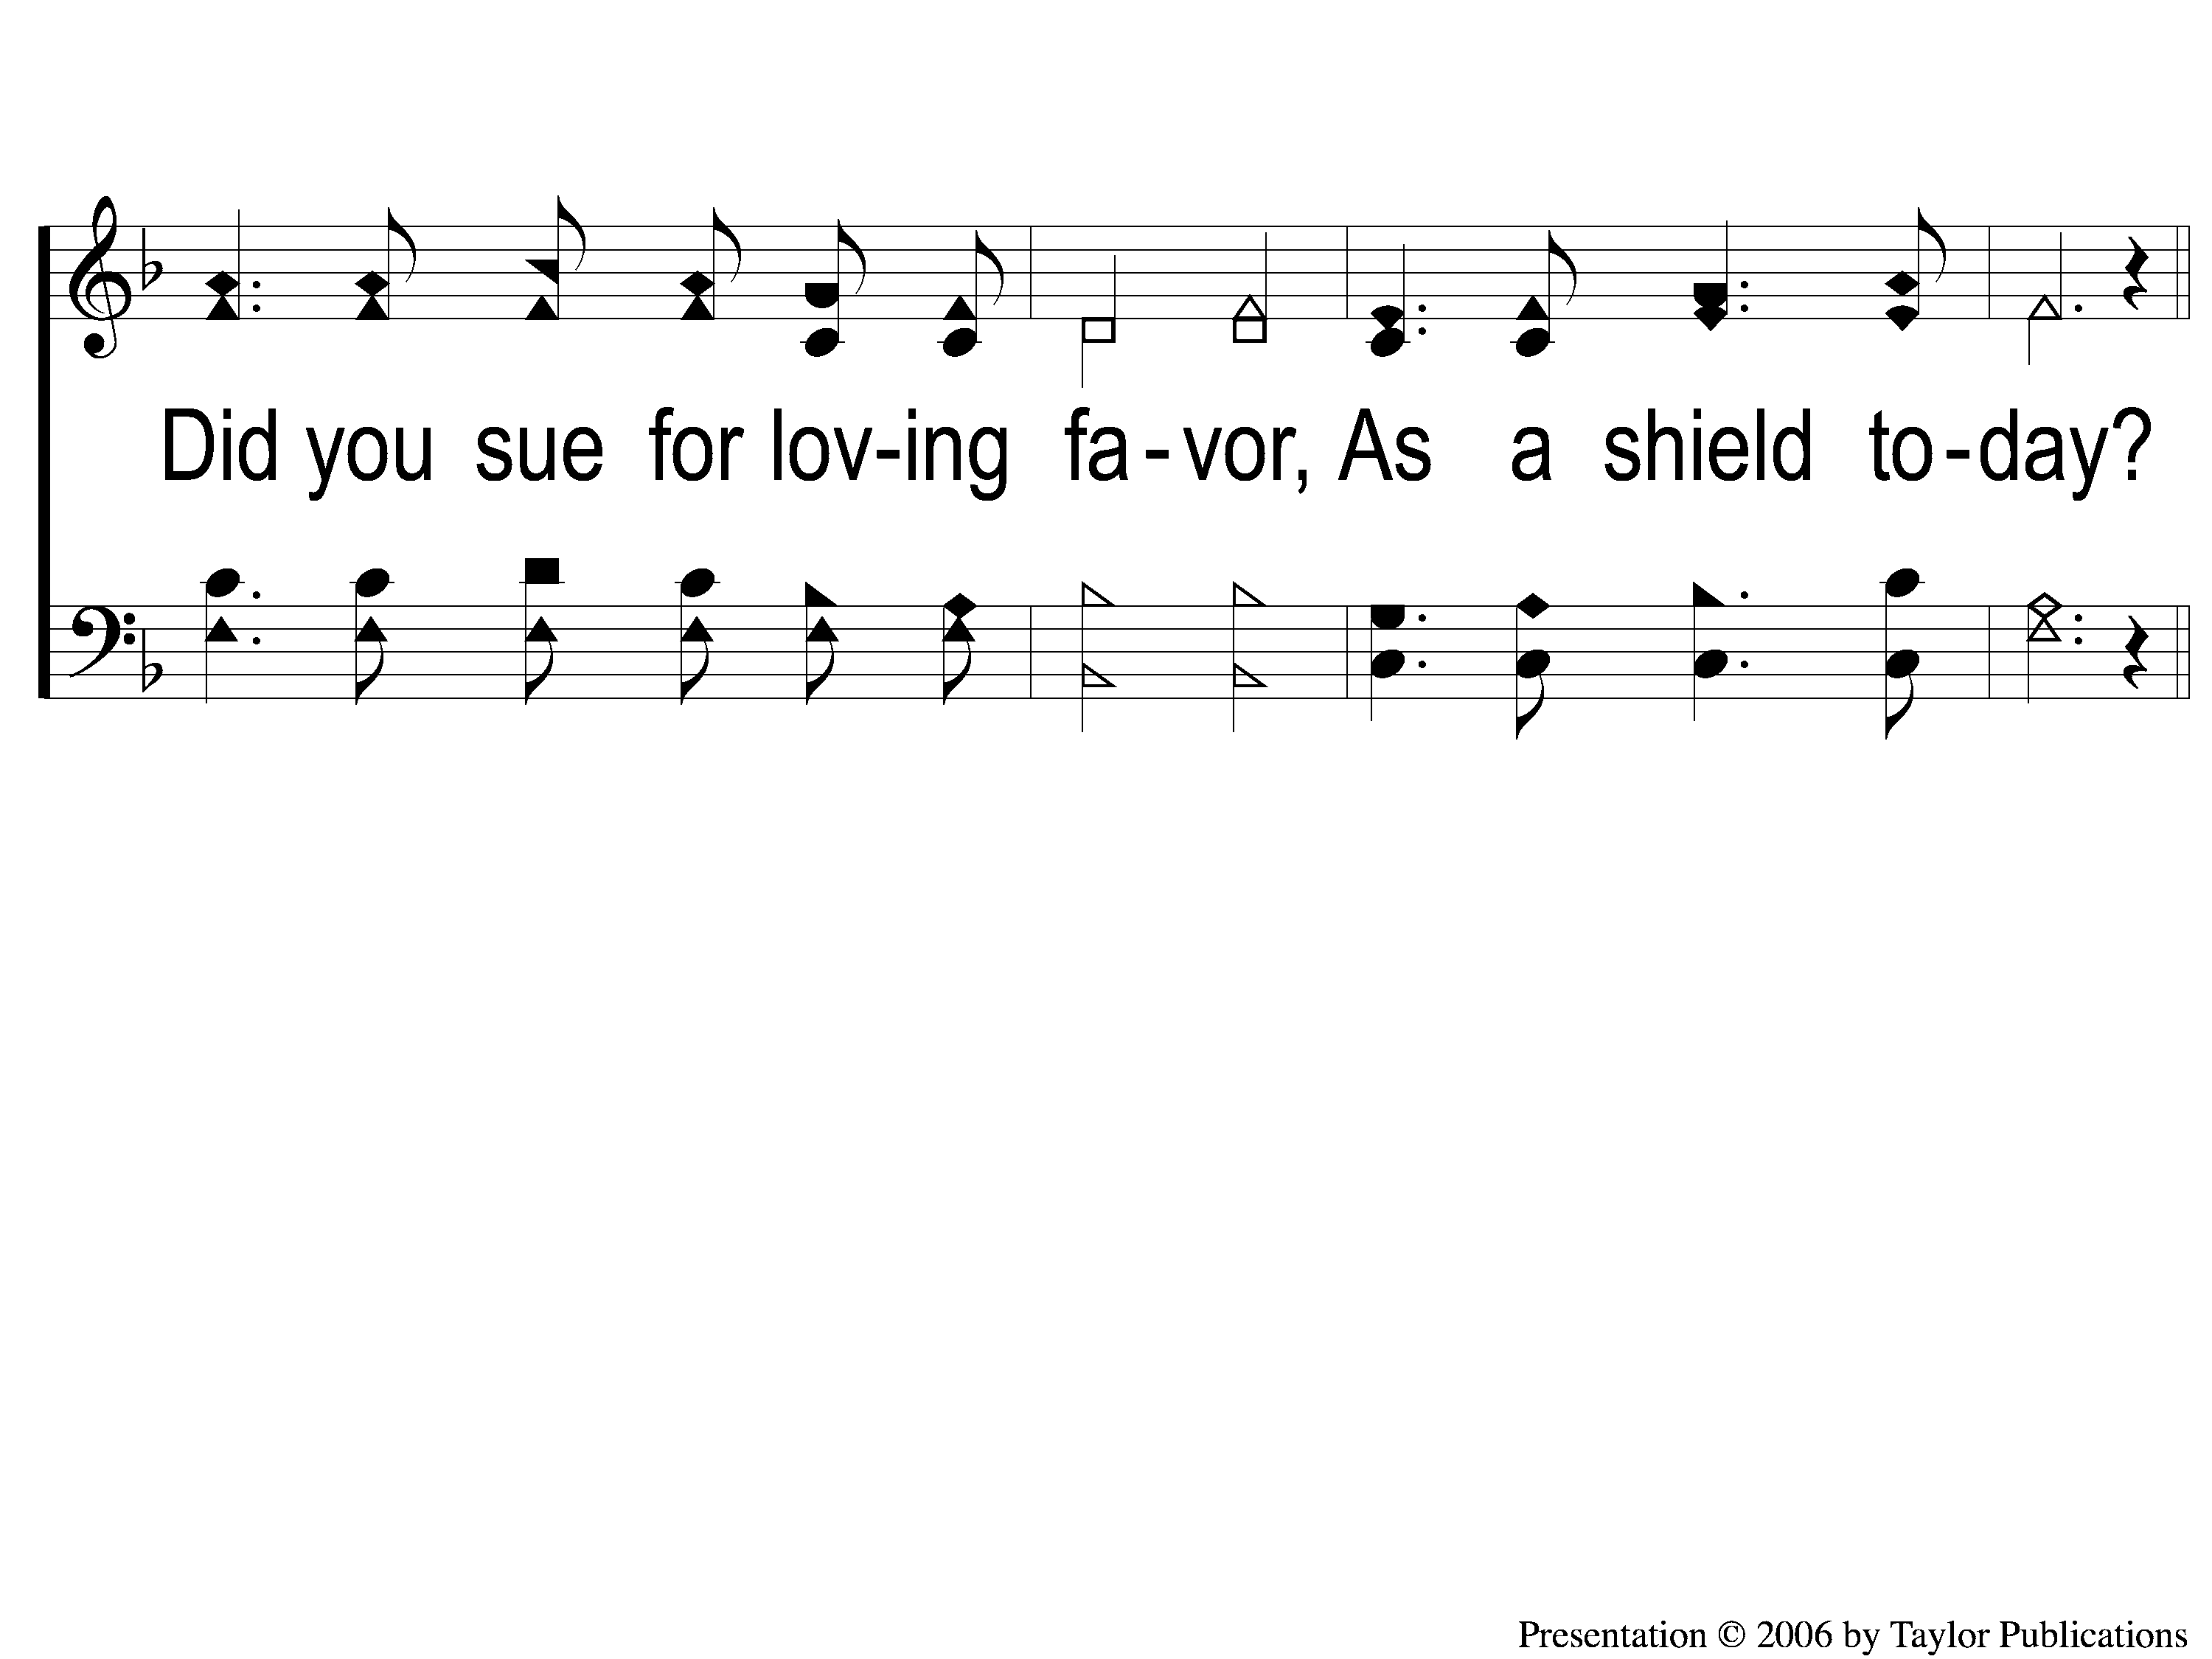
1-2 Ere You Left Your Room this Morning
Ere You Left Your Room this Morning
100

Slide 3
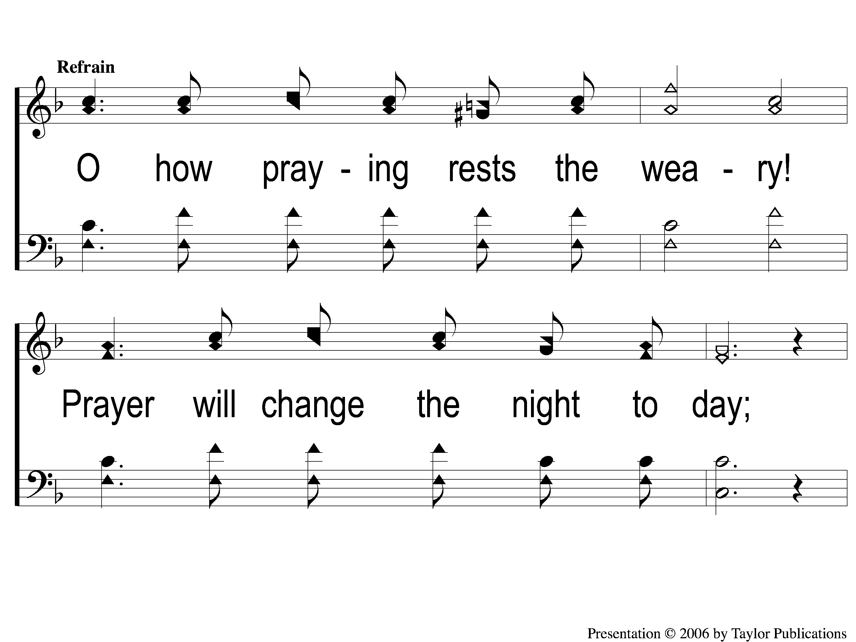
C-1 Ere You Left Your Room this Morning
Ere You Left Your Room this Morning
100

Slide 4
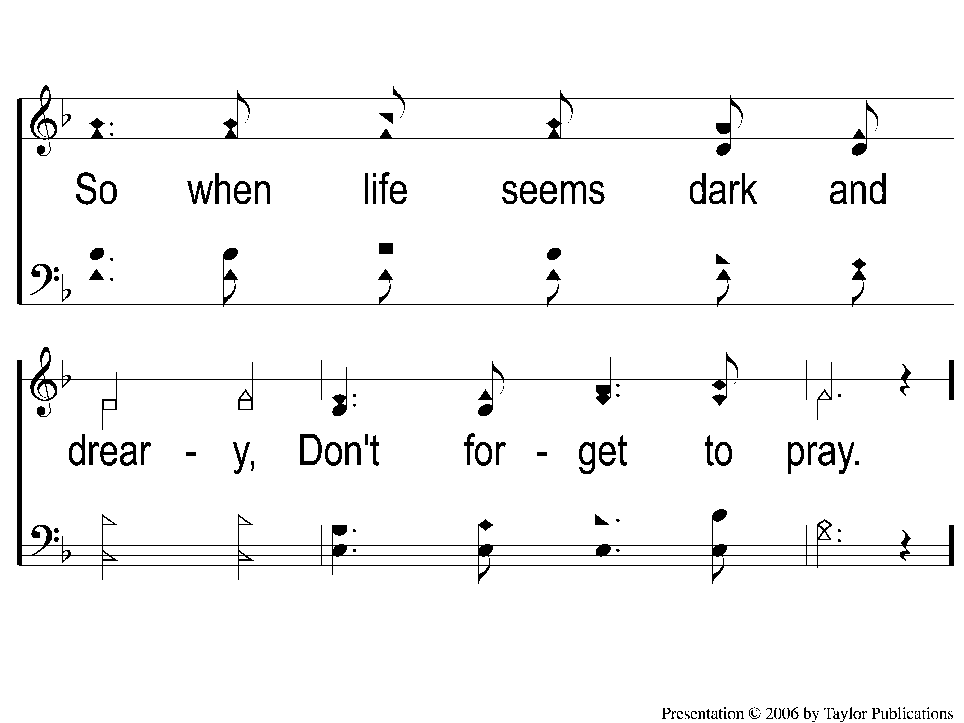
C-2 Ere You Left Your Room this Morning
Ere You Left Your Room this Morning
100

Slide 5
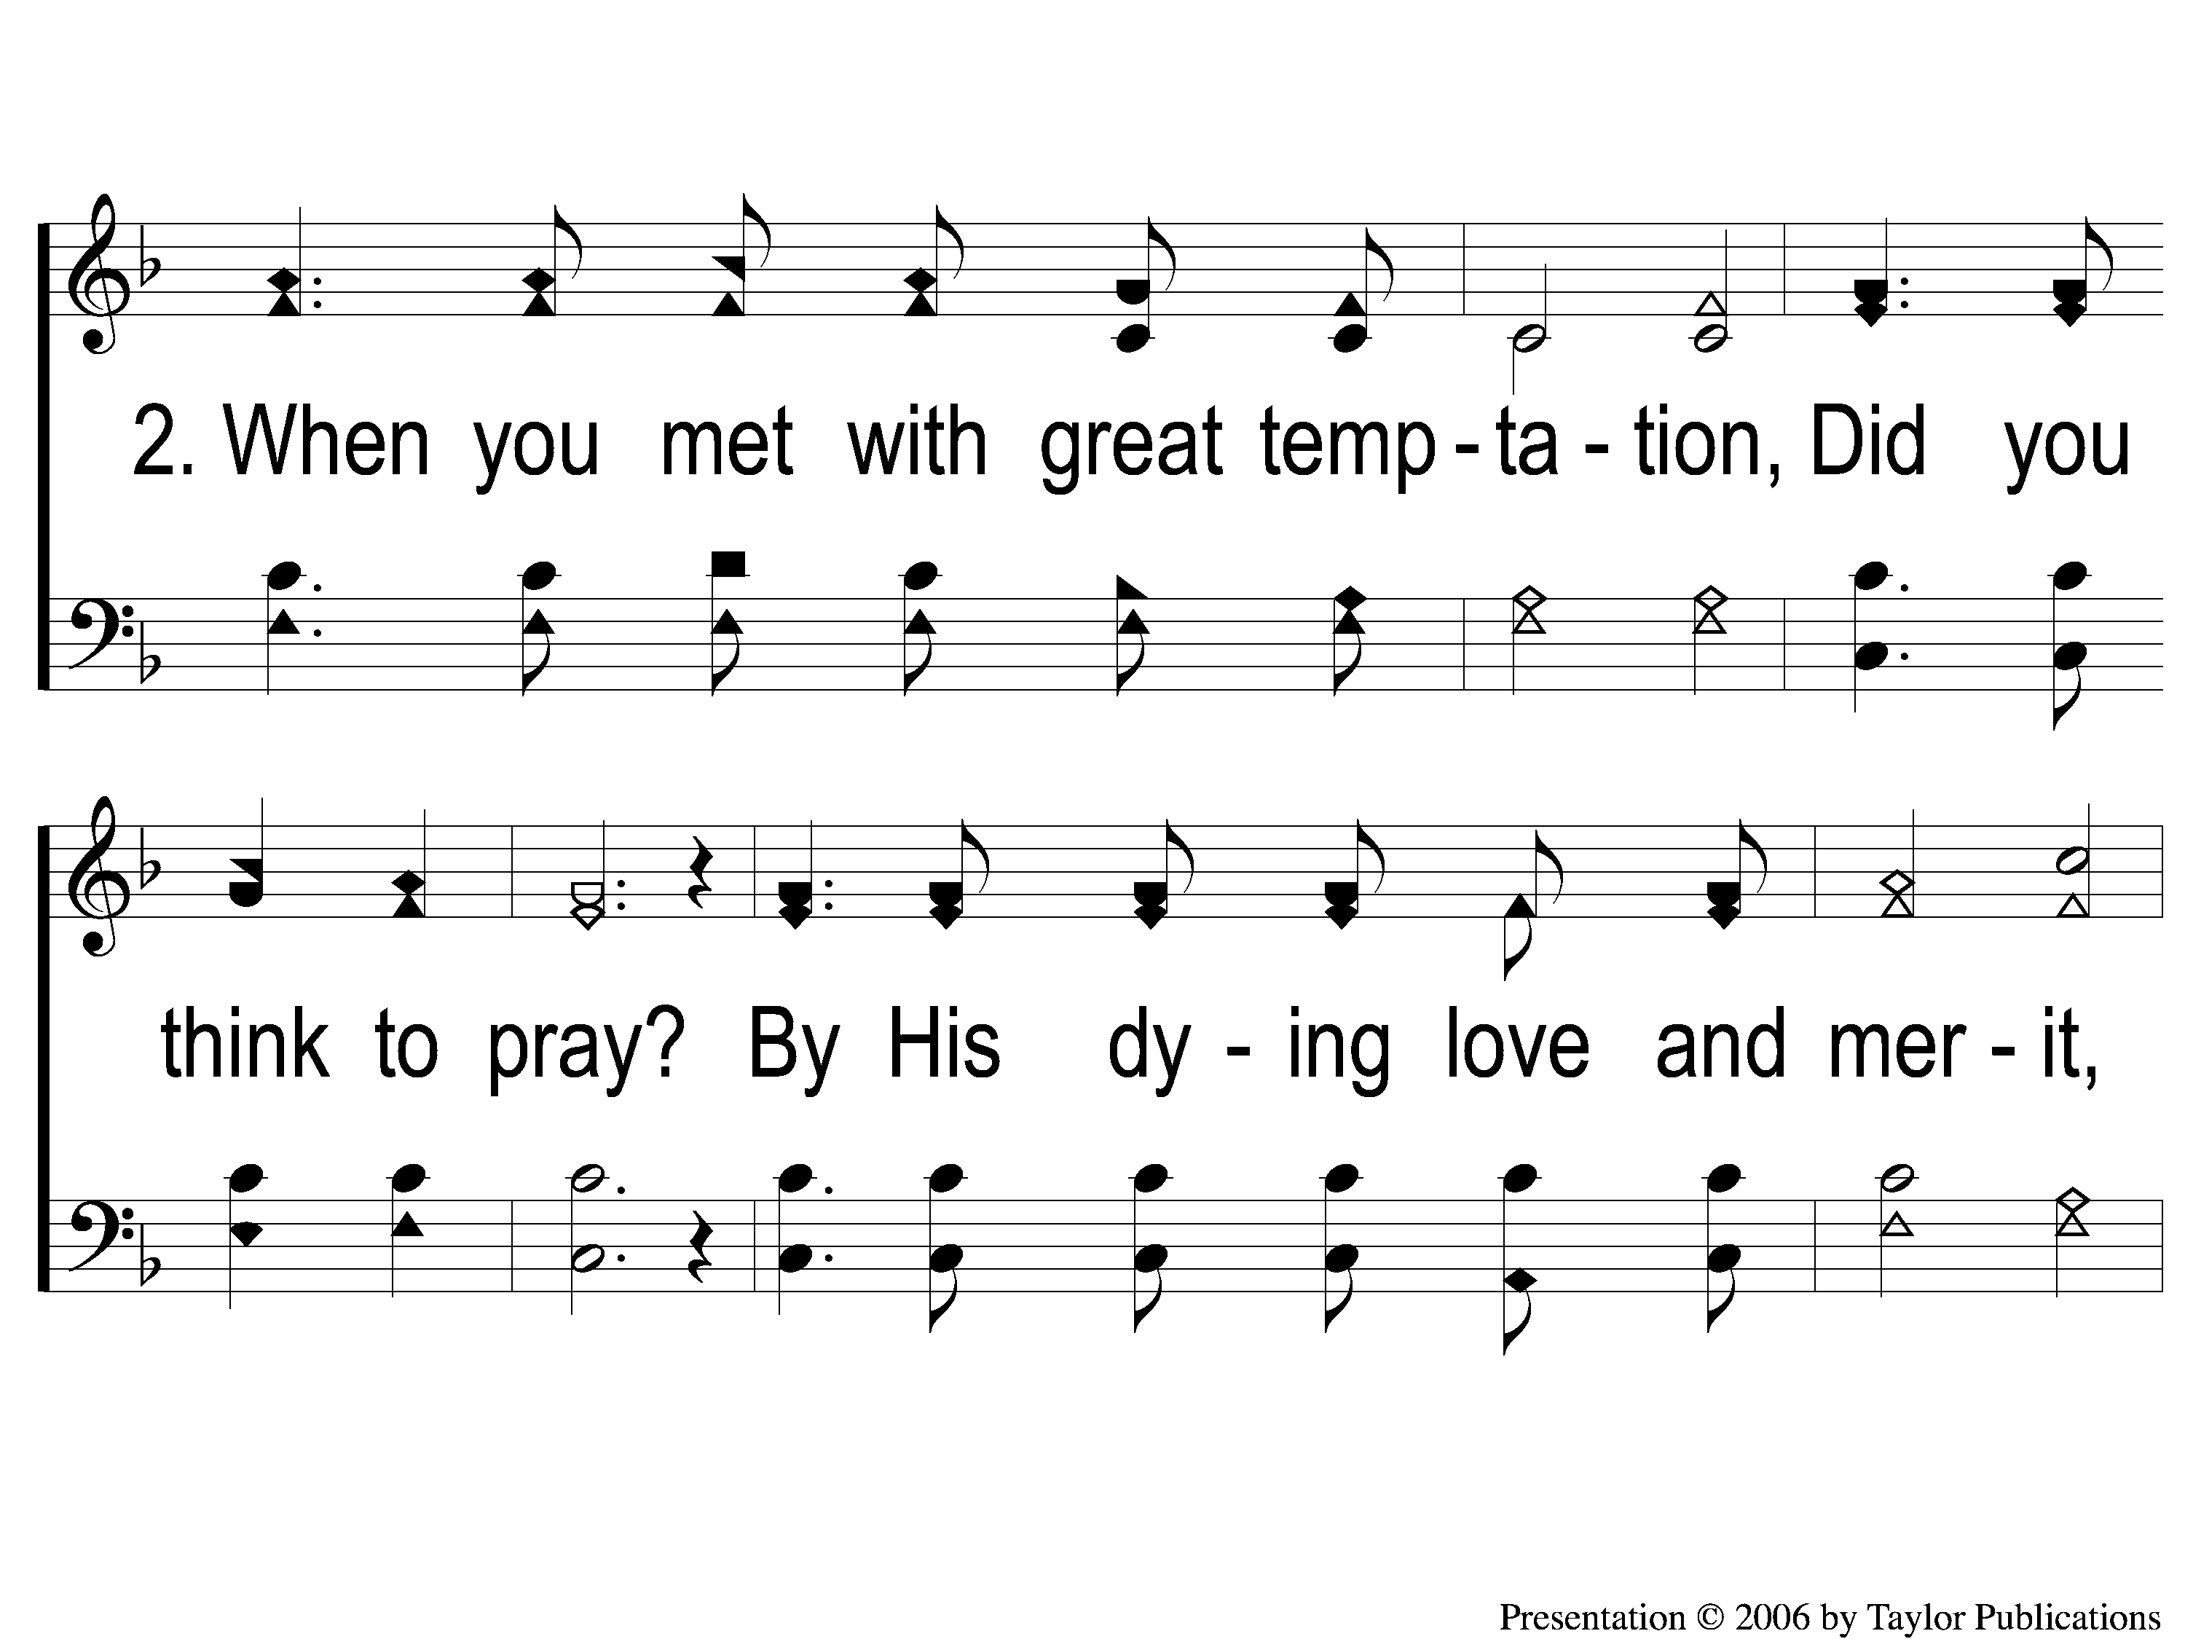
2-1 Ere You Left Your Room this Morning
Ere You Left Your Room this Morning
100

Slide 6
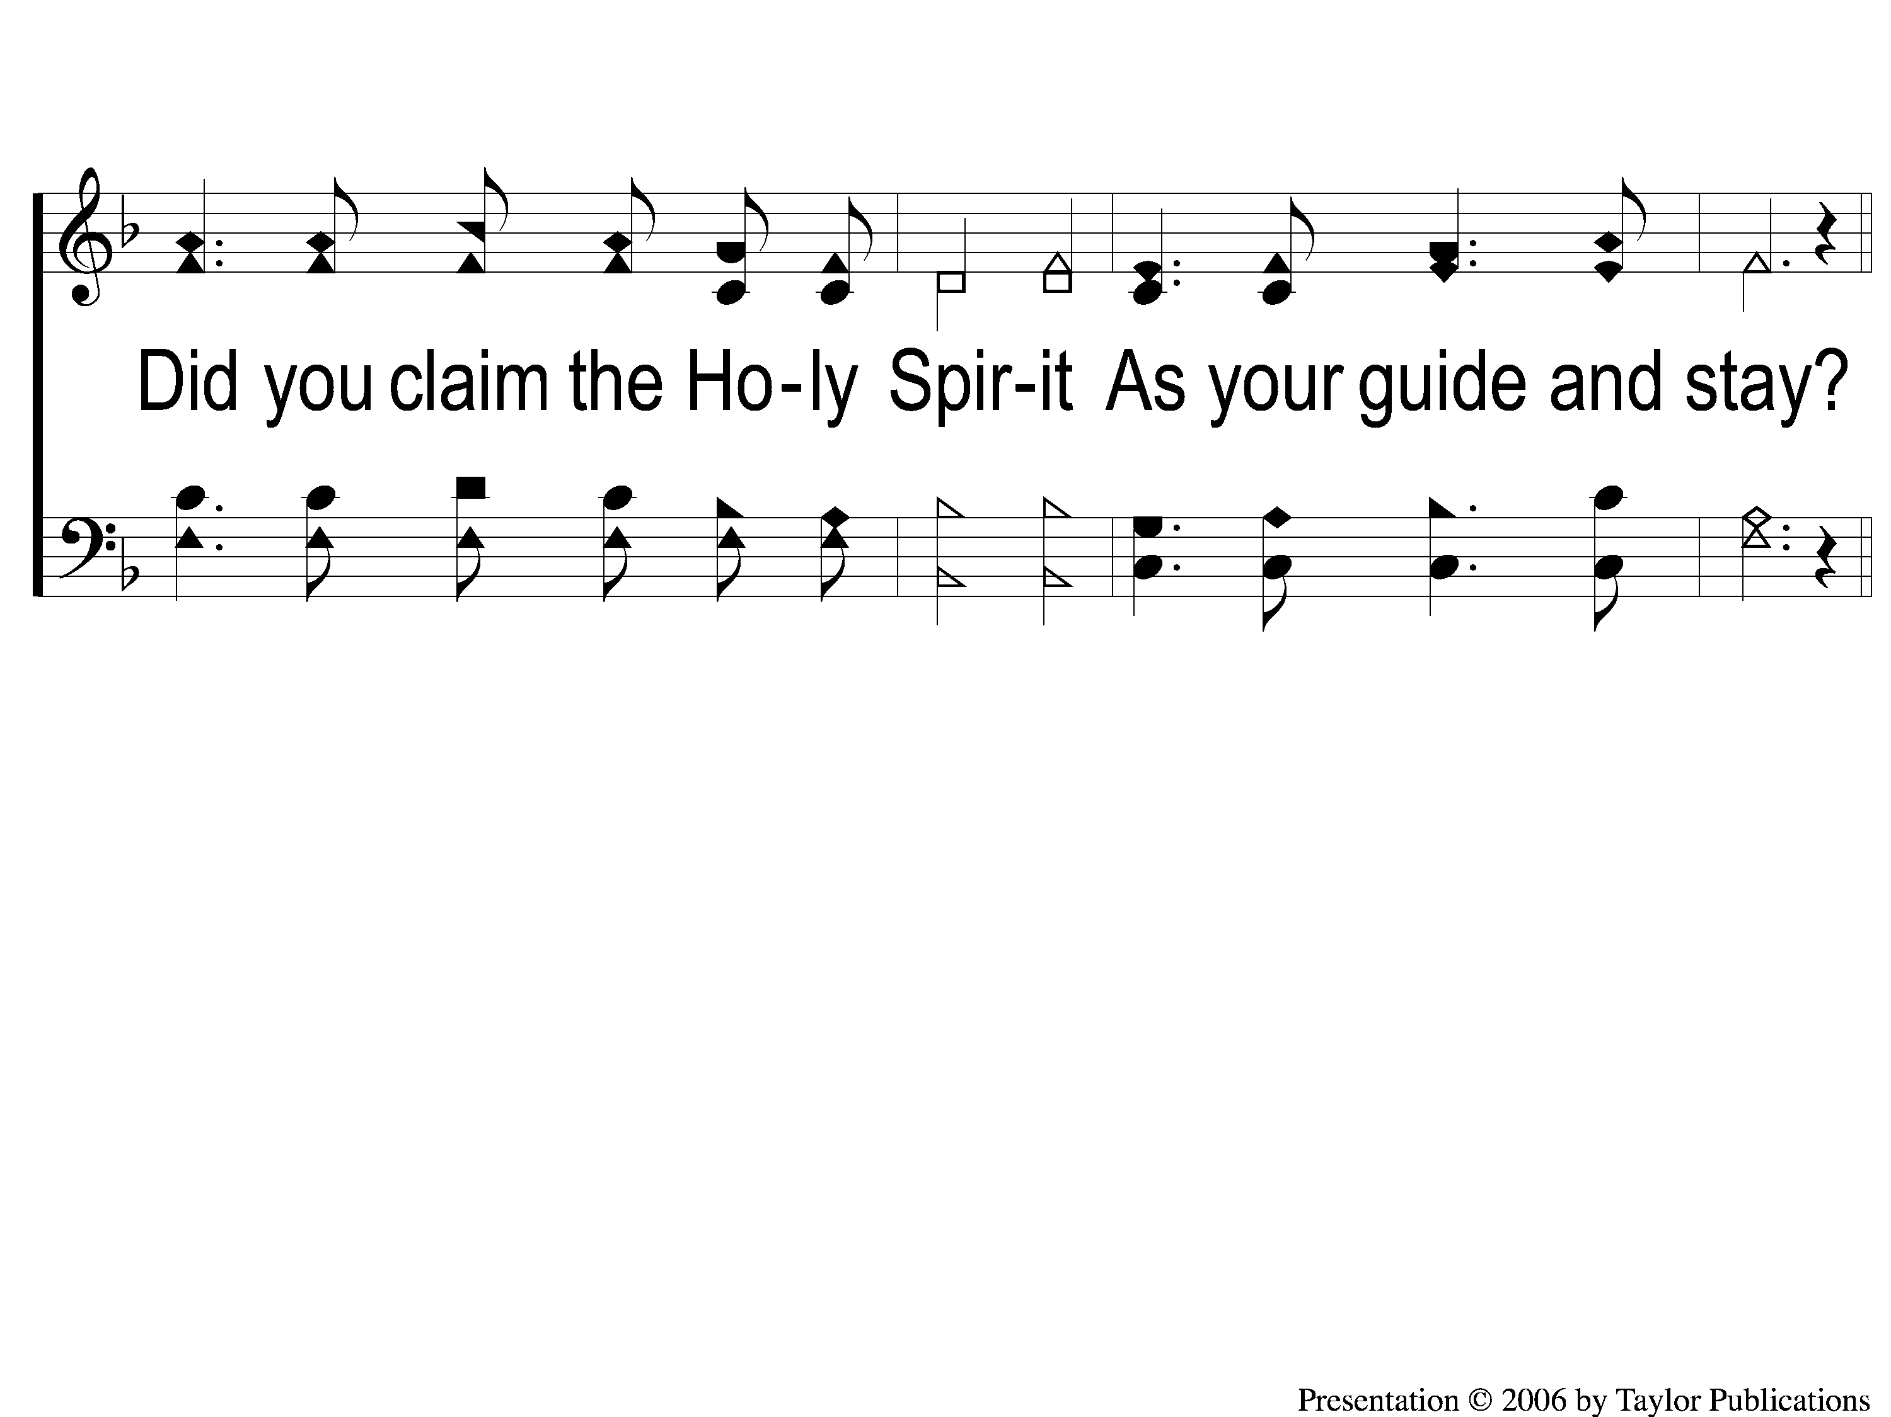
2-2 Ere You Left Your Room this Morning
Ere You Left Your Room this Morning
100

Slide 7
C-1 Ere You Left Your Room this Morning
Ere You Left Your Room this Morning
100

Slide 8
C-2 Ere You Left Your Room this Morning
Ere You Left Your Room this Morning
100

Slide 9
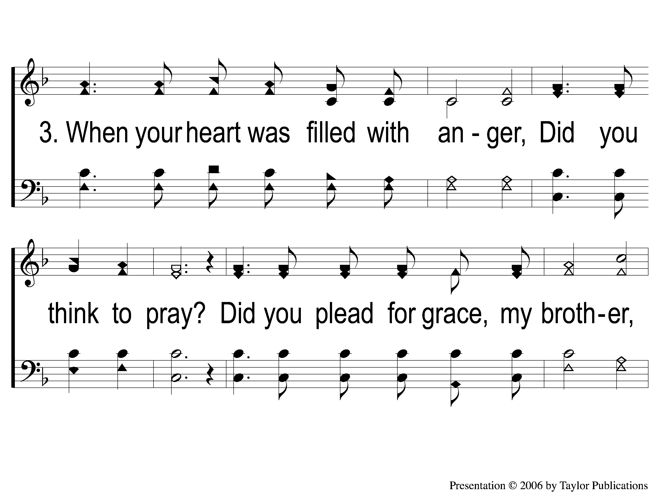
3-1 Ere You Left Your Room this Morning
Ere You Left Your Room this Morning
100

Slide 10
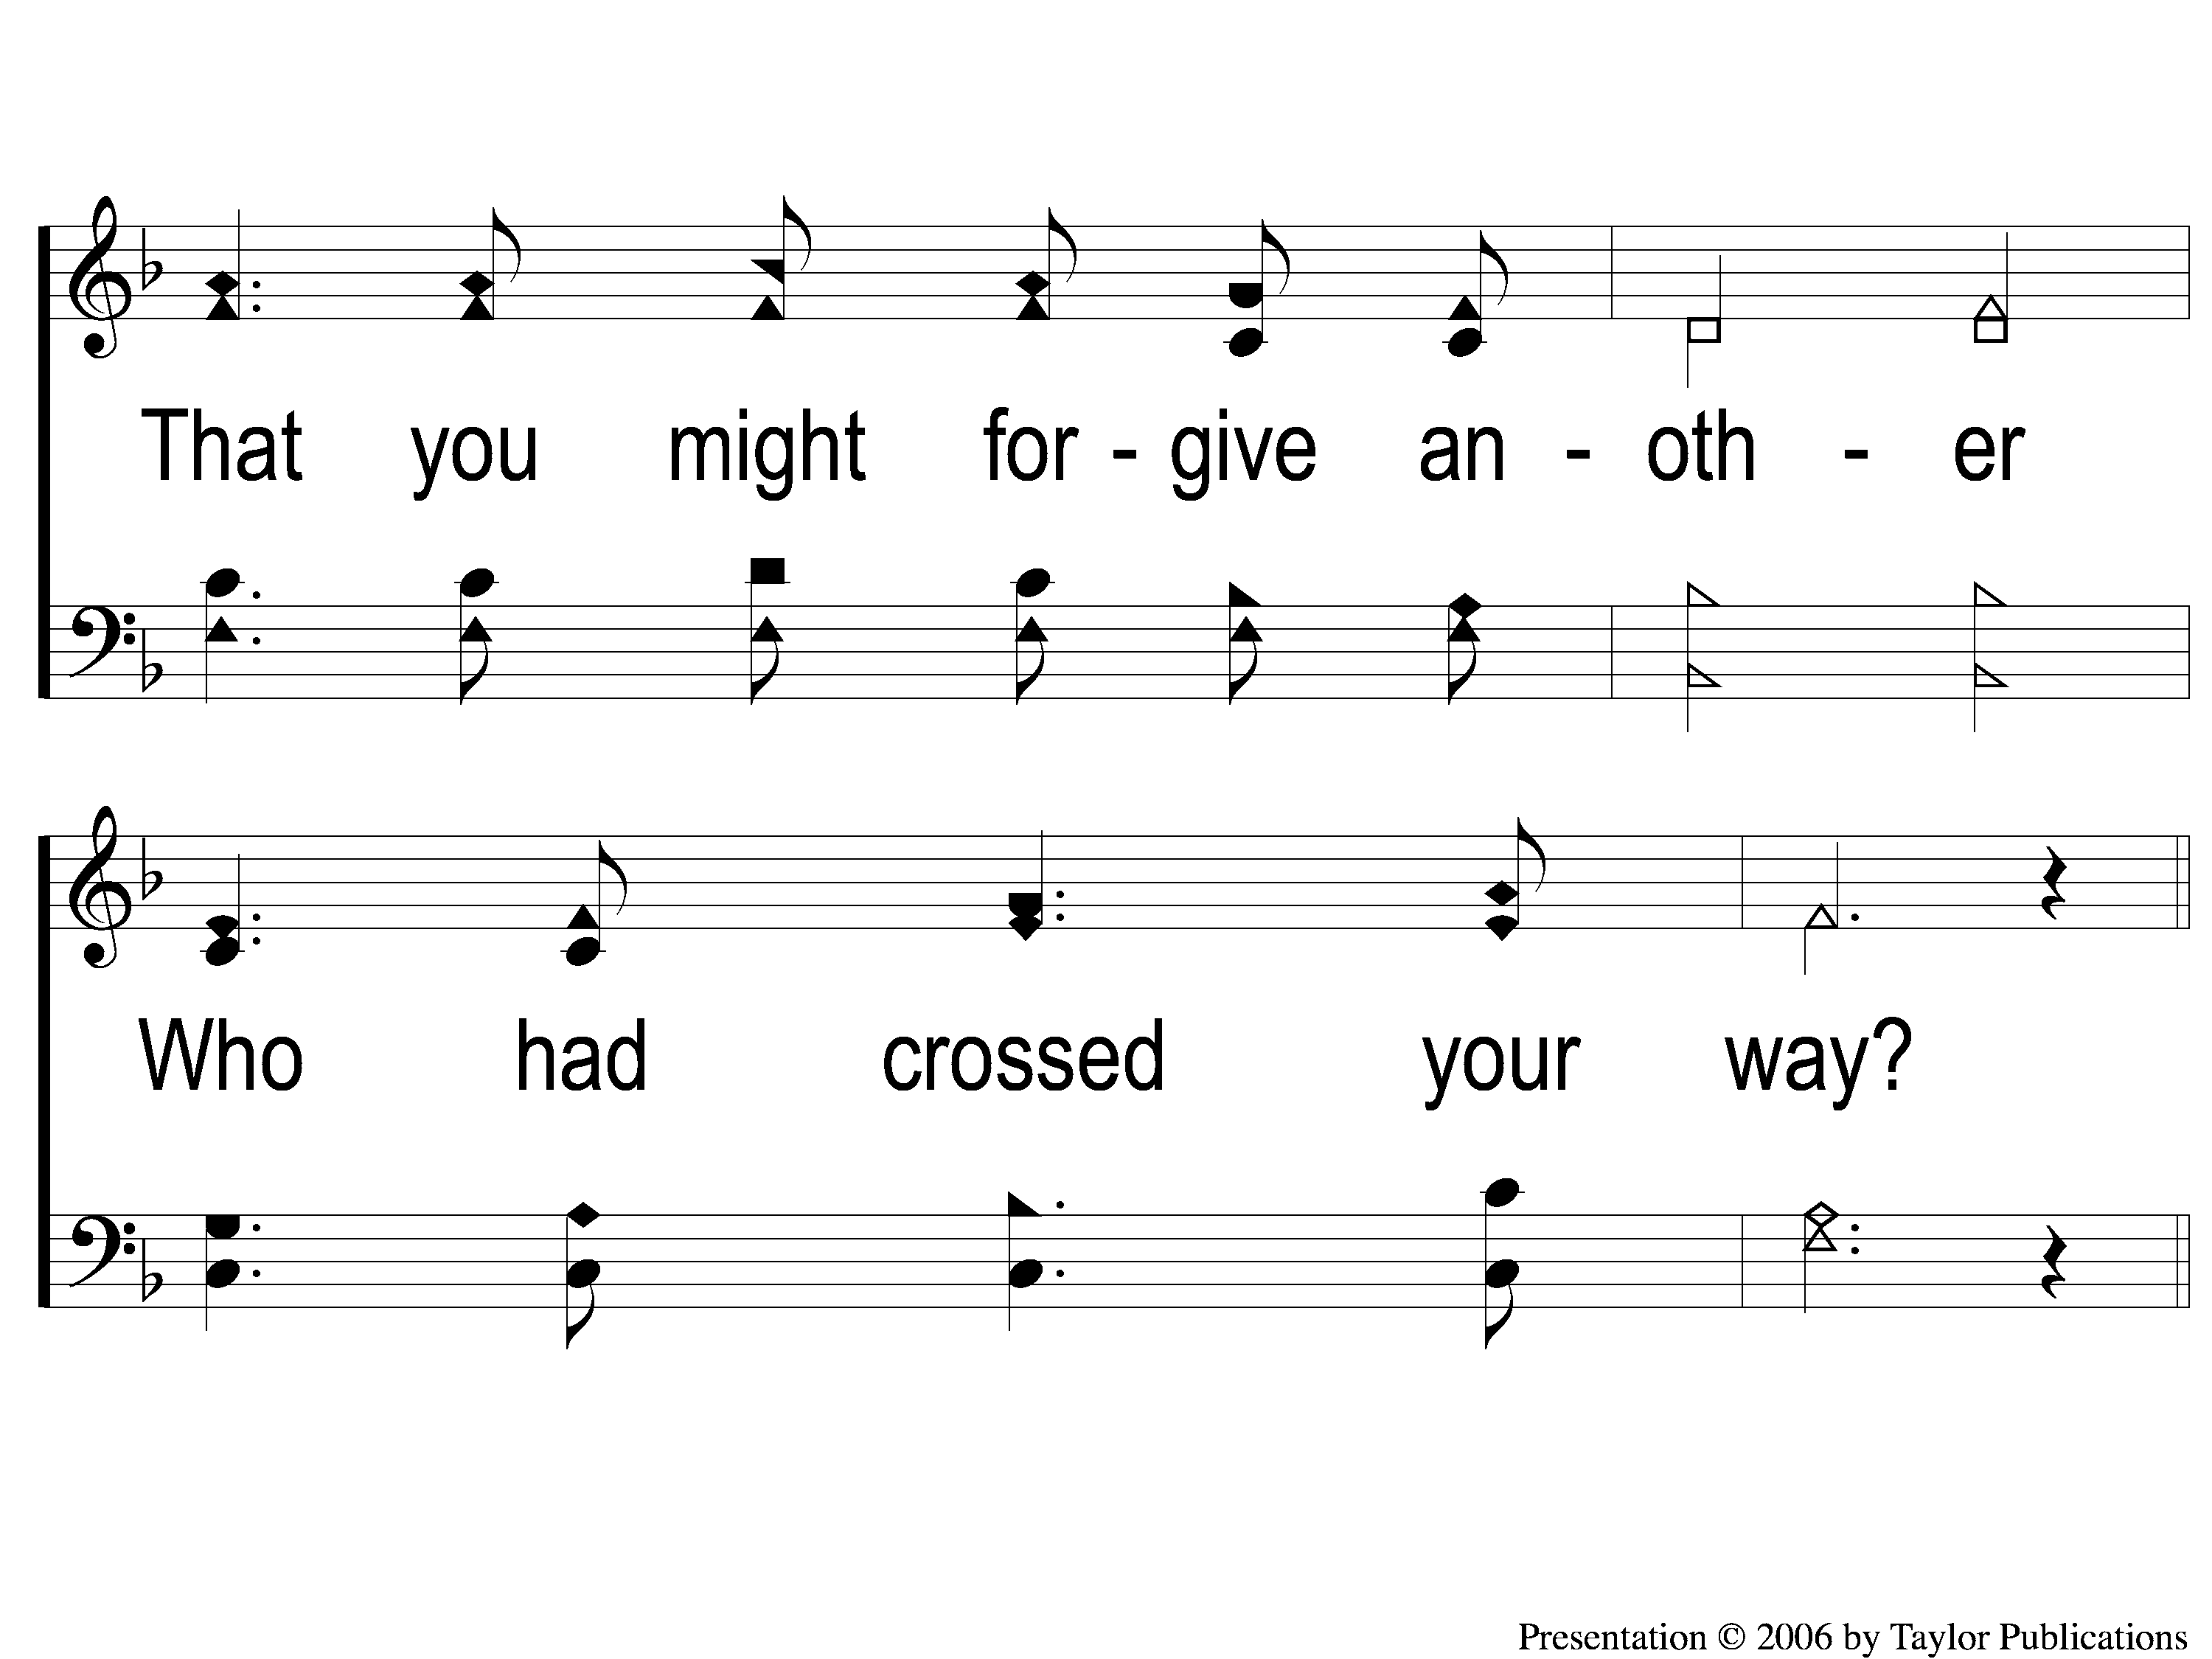
3-2 Ere You Left Your Room this Morning
Ere You Left Your Room this Morning
100

Slide 11
C-1 Ere You Left Your Room this Morning
Ere You Left Your Room this Morning
100

Slide 12
C-2 Ere You Left Your Room this Morning
Ere You Left Your Room this Morning
100

Slide 13
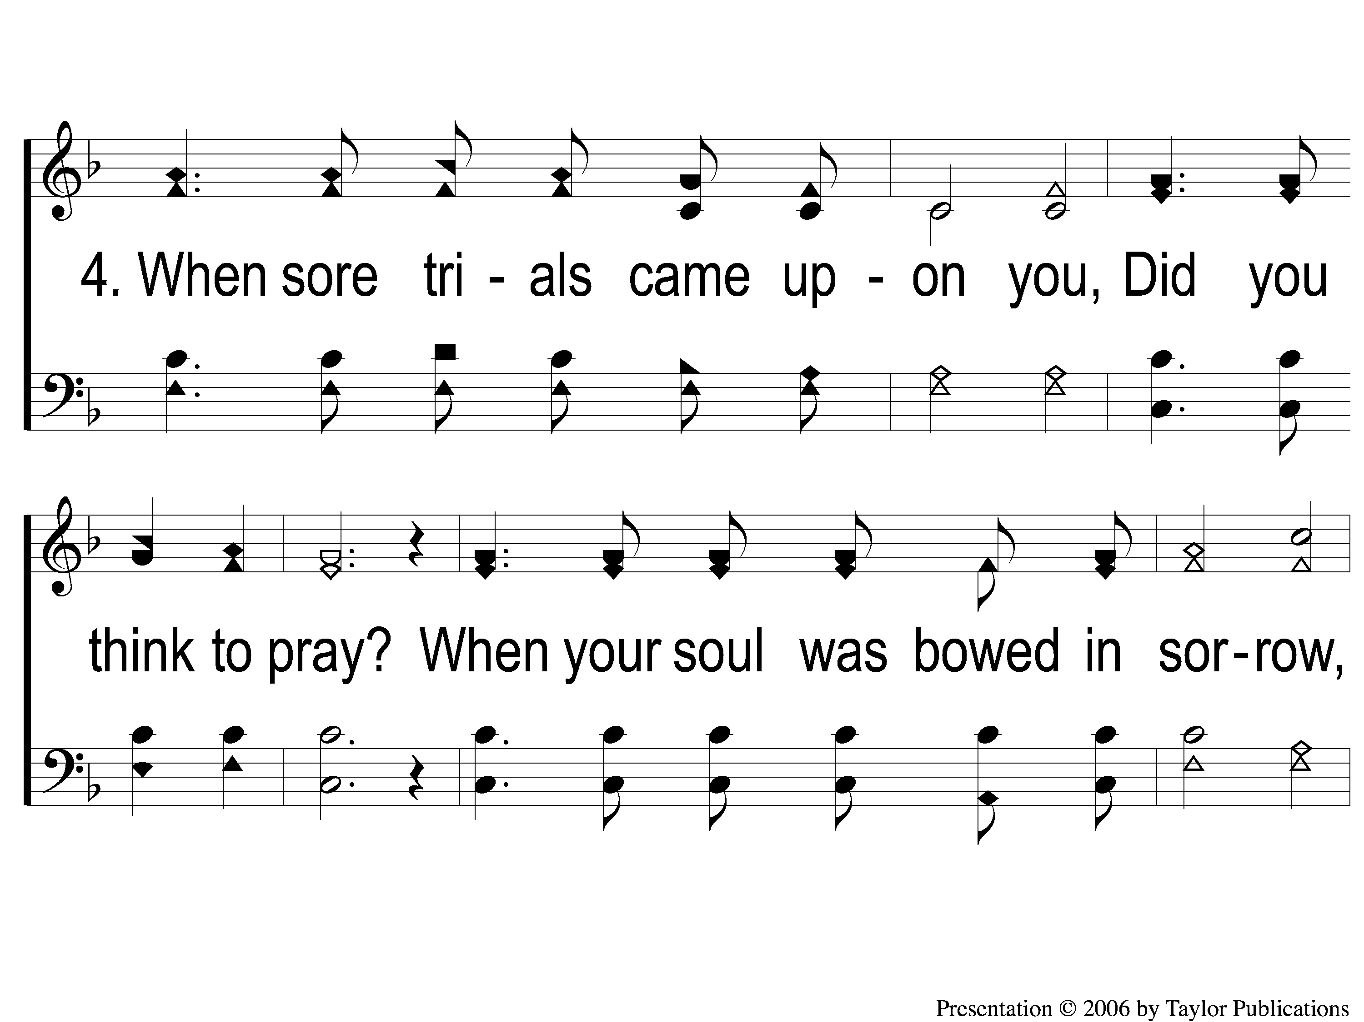
4-1 Ere You Left Your Room this Morning
Ere You Left Your Room this Morning
100

Slide 14
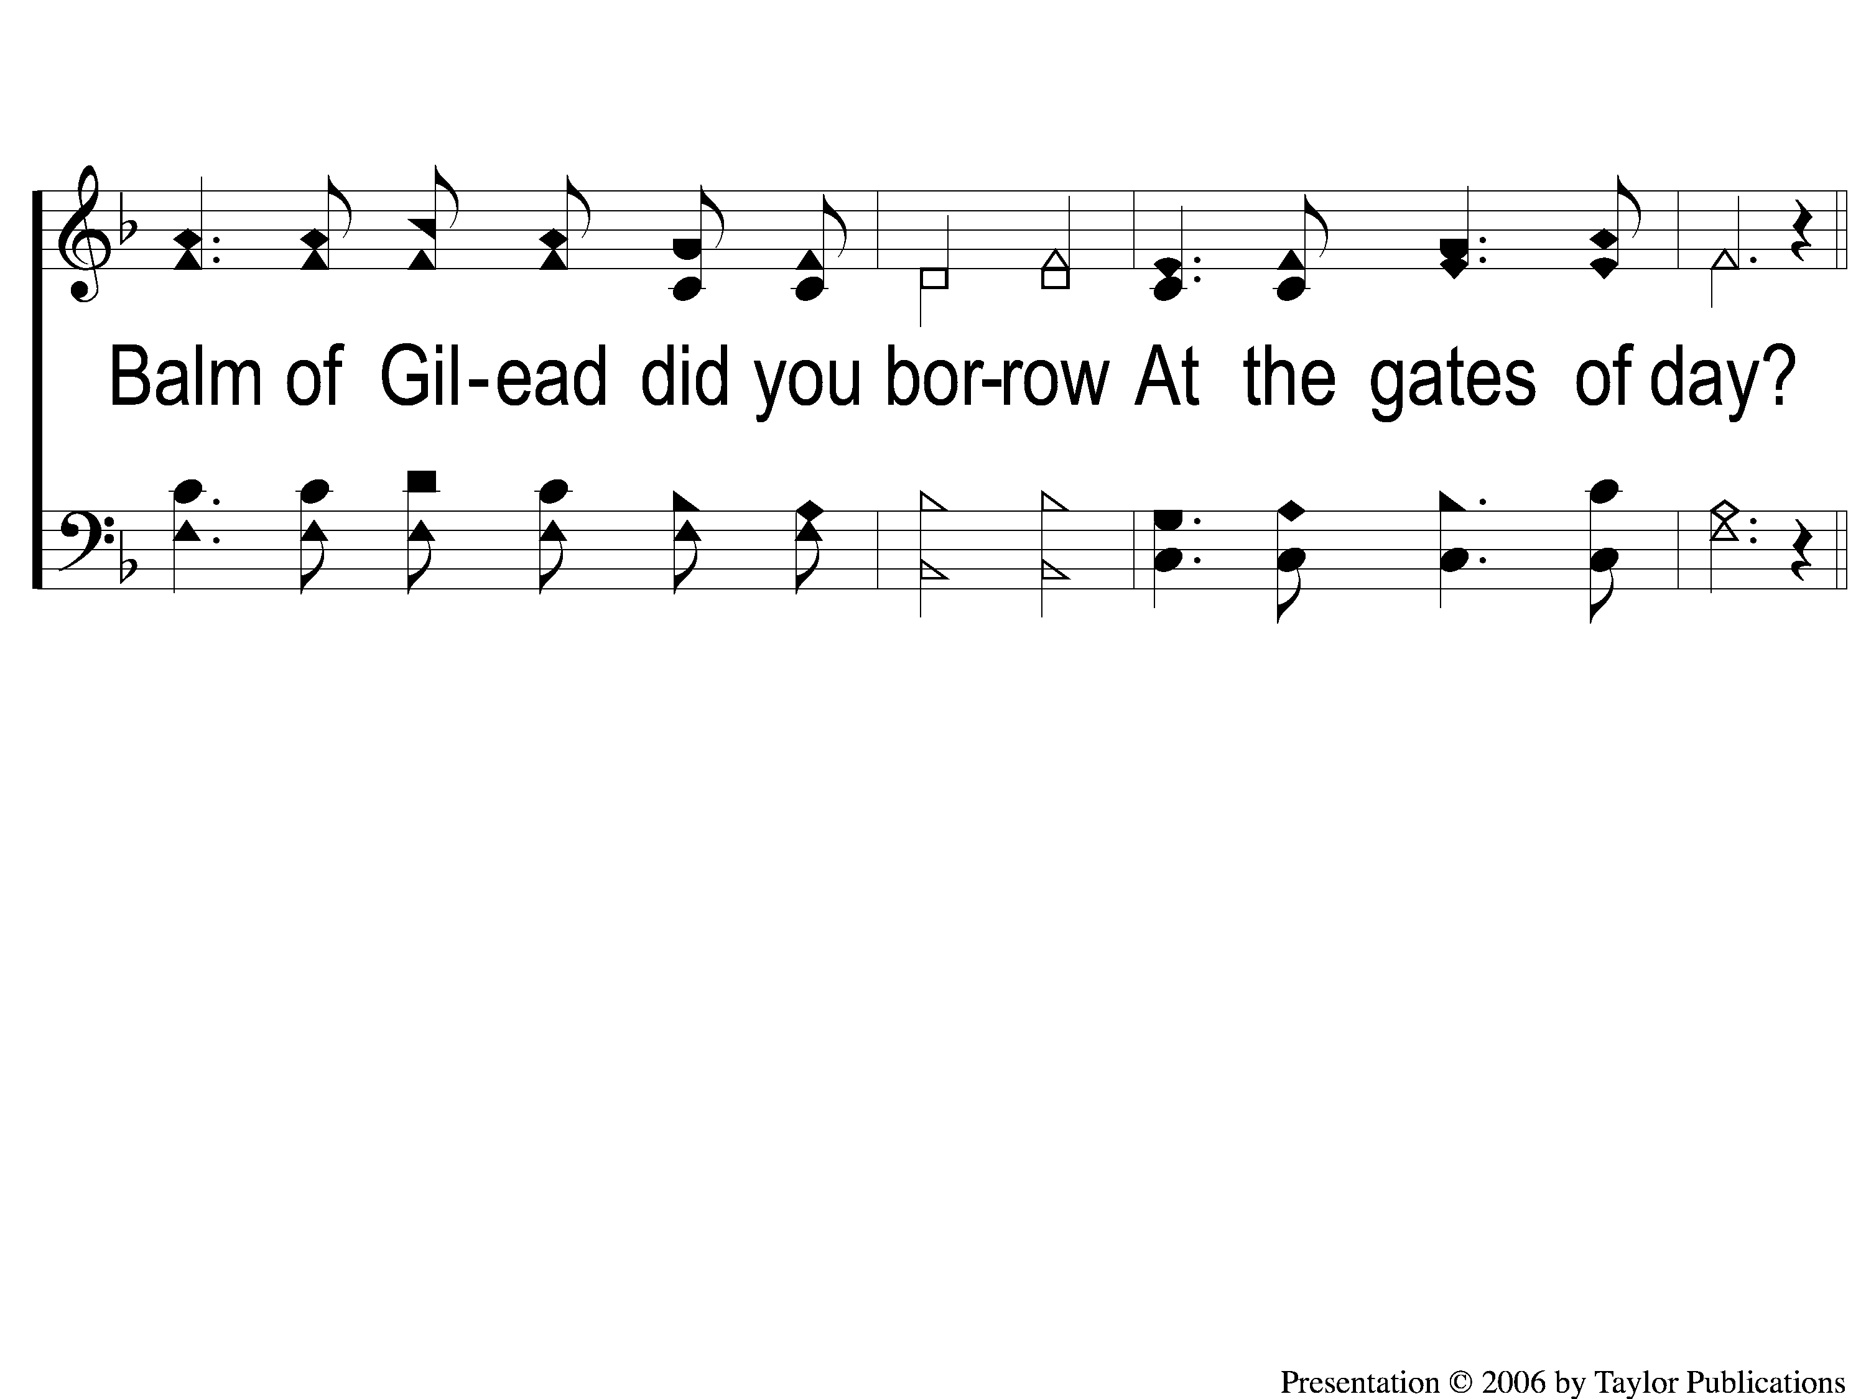
4-2 Ere You Left Your Room this Morning
Ere You Left Your Room this Morning
100

Slide 15
C-1 Ere You Left Your Room this Morning
Ere You Left Your Room this Morning
100

Slide 16
C-2 Ere You Left Your Room this Morning
Ere You Left Your Room this Morning
100

